Slide 1
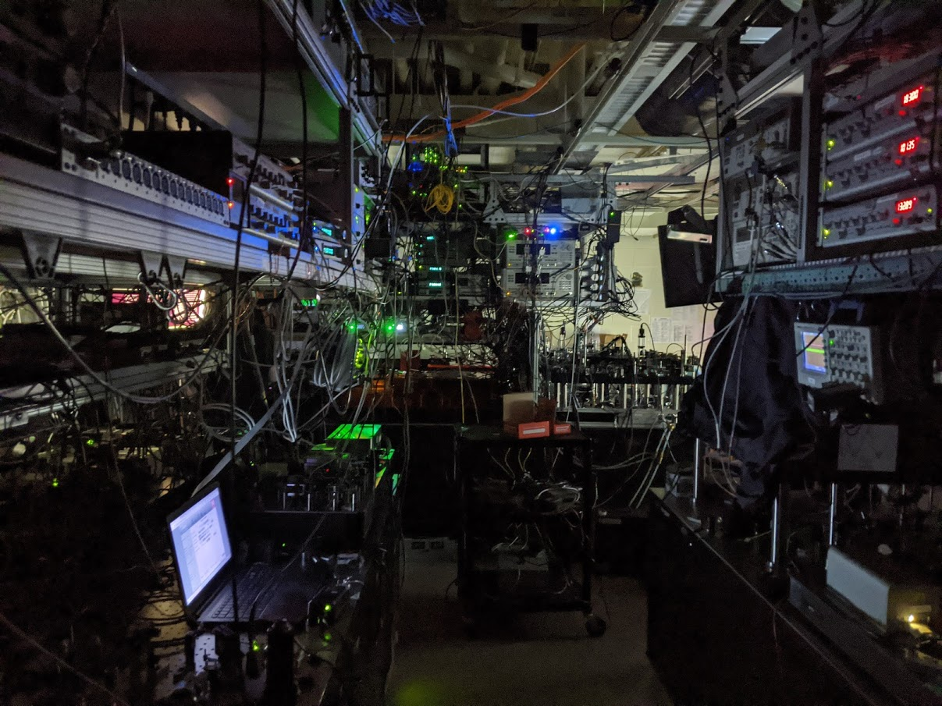










Demonstration of multi-qubit algorithms
on a programmable neutral-atom quantum computer
T. M. Graham*
Yunheung Song*
J. Scott
C. Poole
L. Phuttitarn
K. Jooya
P. Eichler
X. Jiang
A. Marra
B. Grinkemeyer
M. Kwon
M. Ebert
J. Cherek
M. T. Lichtman
M. Gillette
D. Bowman
J. Gilbert
T. Balance
C. Campbell
E. D. Dahl
T. Noel
O. Crawford
N. S. Blunt
B. Rogers
Mark Saffman
Nature 604, 457 (2022)
wqi.wisc.edu
wqi.wisc.edu

Slide 2
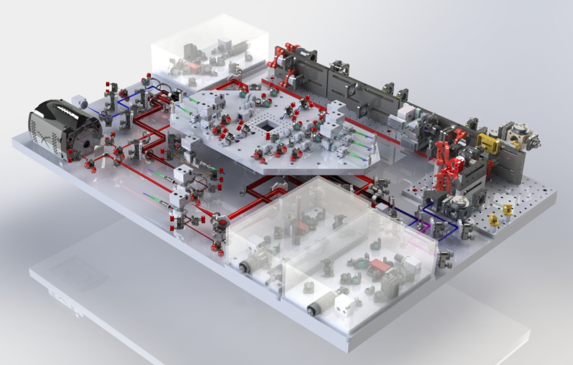
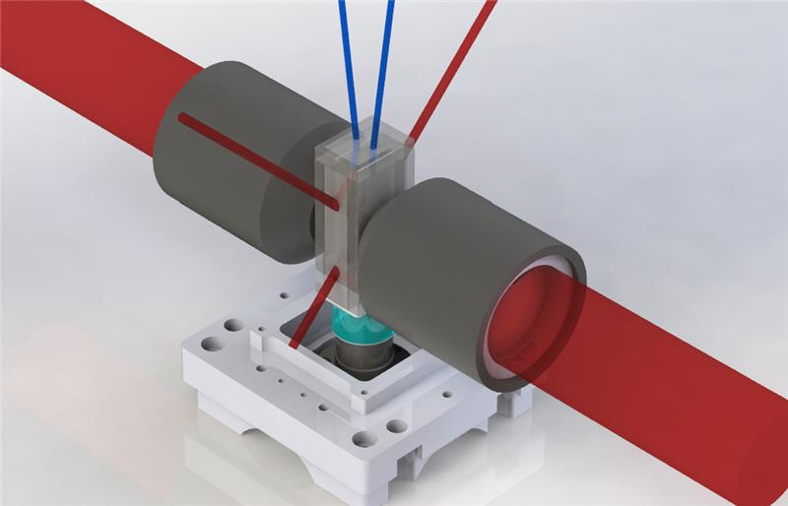
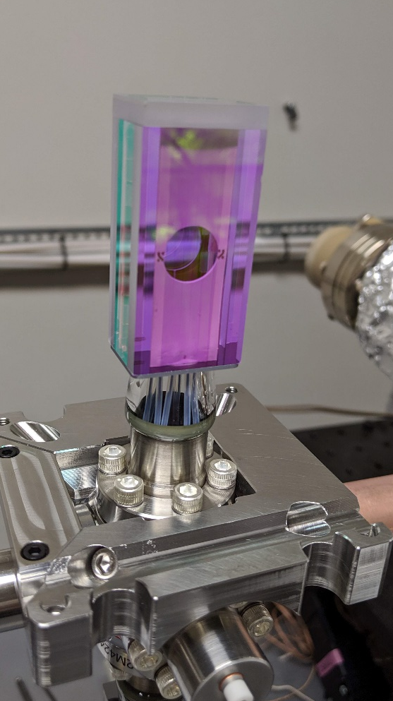
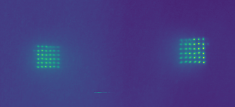
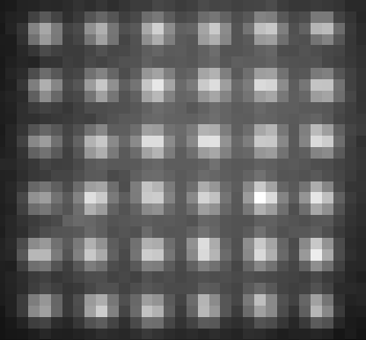
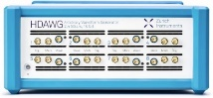
New machine
825 nm blue array and axial lattice
UHV cell with
electrodes
QPU
459 nm
Rydberg
scanner
cooling light
Cooling & imaging
optics
camera
dynamic
line array
NA 0.7
Control system, Lasers & electronics upgrades
Atom
rearranger
1038 nm
Rydberg
scanner
Individual and dual atom addressing.
New gate protocols and circuits under test.
Running arbitrary quantum circuits.

Slide 3
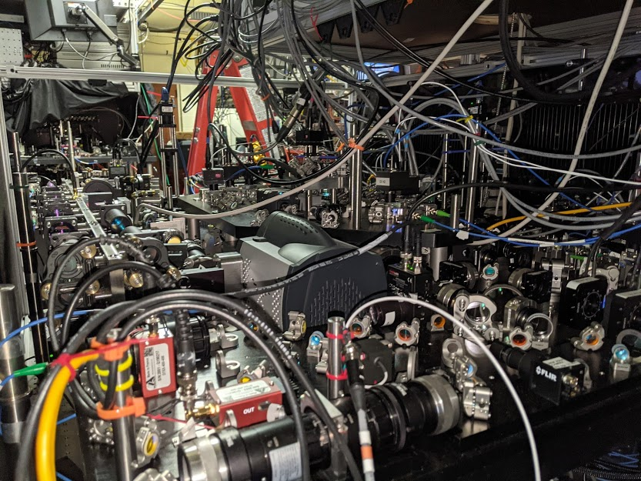

Slide 4
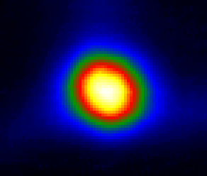
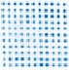
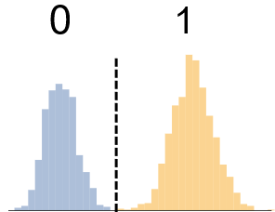
Operational Sequence
Qubit Register Preparation
Calculation Cycle
Cold
Atoms
Single Atom
Array
Filled
Array
State
Initialization
Quantum
Circuit
Measure
Results
1
0
f=4
|1>
Cesium
f=3
|0>
Camera
Camera
Camera
Optical Pumping
895 nm laser
Gates
1Q, 2Q
459 nm, 1040 nm lasers, μwaves
Laser cooling
852,894 nm lasers
Array
825 nm lasers,
Deep cooling
Rearrange-ment
1064 nm
laser
852 nm lasers
Controlling the Mechanics
Controlling the Quantum

Slide 5
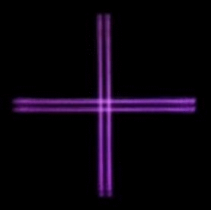
Scalable qubit registers
Dynamic line array
Up to 500 sites, currently in use.
Controllable site number and array spacing
7X7 array used in circuits
Gaussian line array

Slide 6
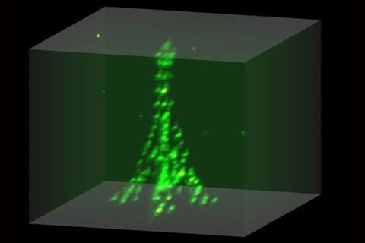

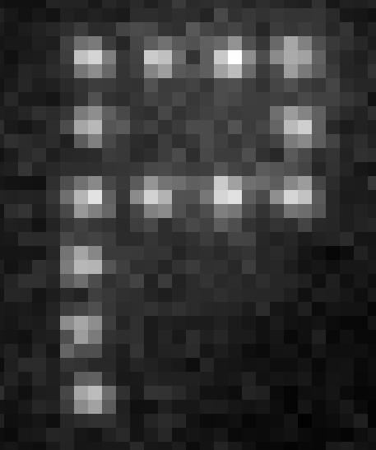
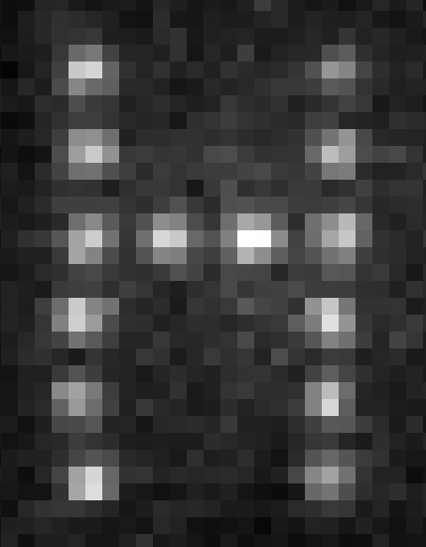
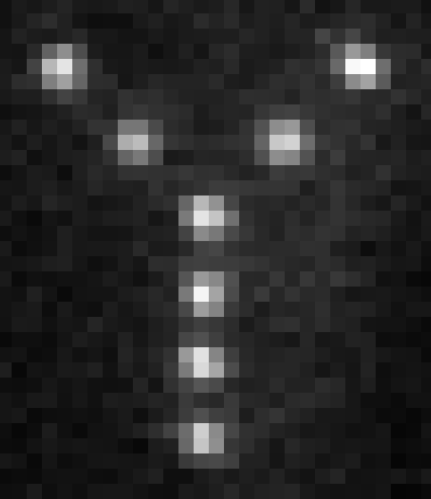
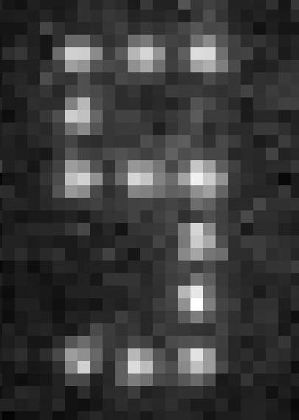
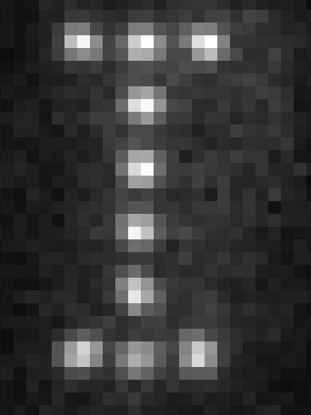
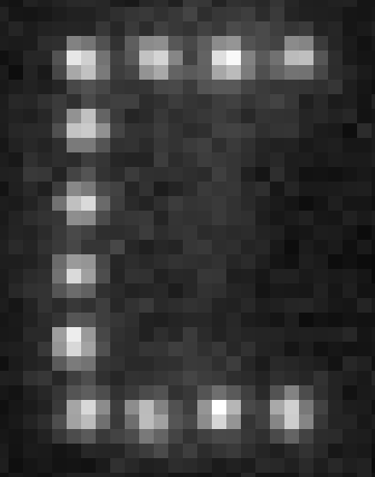
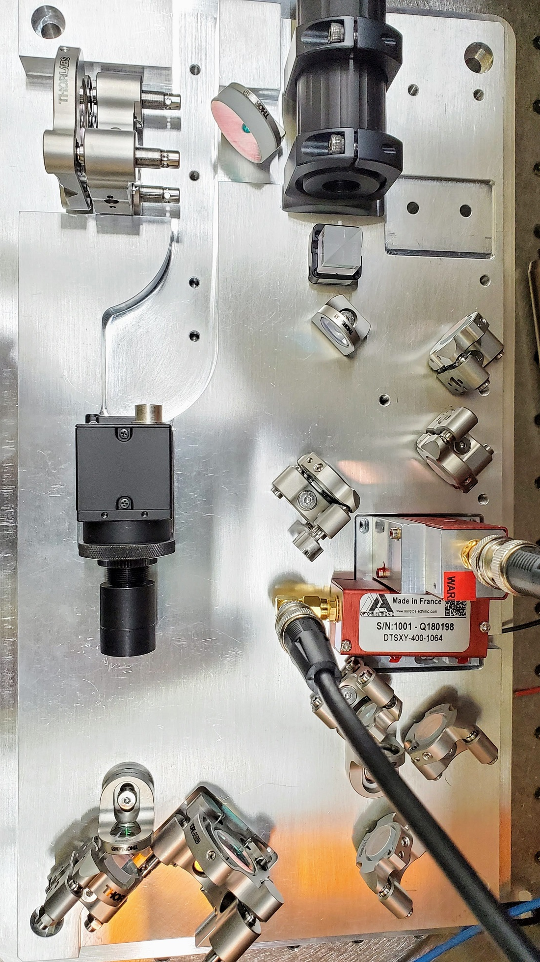
Atom Rearrangement
Loading single atoms into a trap array
is a stochastic process.
The array is deterministically filled using
“atom rearrangement”.
Works in 1D, 2D, 3D
KAIST, Paris, Harvard, Darmstadt, Wuhan,
Moscow, ….
Gaussian line array
Gaussian line array
Browaeys group (2019)
2D acousto-optic scanner
25x25=625 site spot array
3 μm

Slide 7
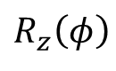
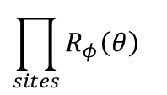
Gate set
Cs
f=4
Encode in Cs clock states:
Universal gate set:
Global gates
microwaves
Single site optical
Stark shift
|1>
9.2 GHz
f=3
|0>
m_{f}=0
$$\prod_{sites}{R_{φ}\left(θ\right)}$$
Rydberg blockade
Angle φ in x-y plane
from μwave phase
i,j site indices or more
$$R_{z}\left(φ\right)$$
Native multi-qubit gates are also possible: (CNOT)^{k}, C_{k}NOT. Toffoli k=2 demonstrated at Harvard.

Slide 8
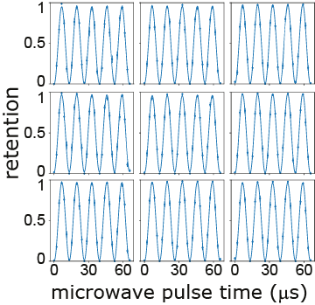
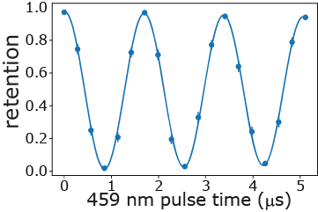
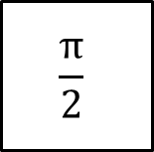
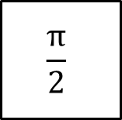
Single-qubit gate performance
Global microwave Rabi oscillation
Local Stark shift by 459 nm laser
μwave
459 pulse
μwave
$$\frac{π}{2}$$
$$\frac{π}{2}$$
t
T_{π} = 6.5 μs << T₂* = 3.5 ms
f_{stark} × τ_{decay} = 32

Slide 9
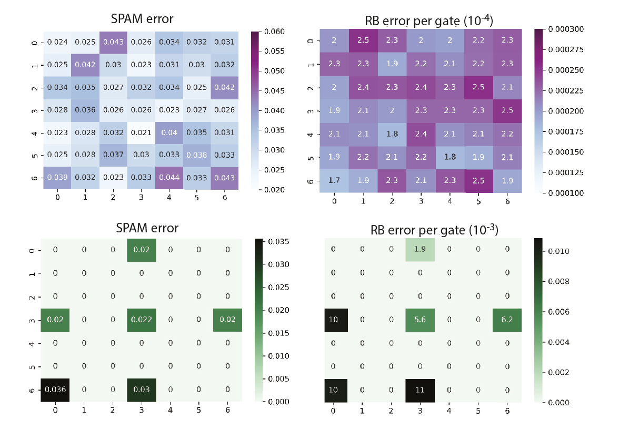
Single-qubit gate performance – randomized benchmarking
Averaged performance over all sites
Global
gates
SPAM error : 2.5%
F_{global} = 99.978%
F_{local} = 99.25%
Could be further improved by better cooling, more laser power and detuning, beam shaping …
Local
gates

Slide 10
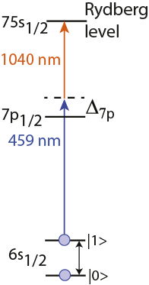
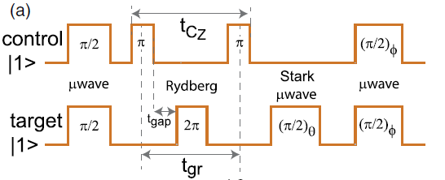
Improved two-qubit gate – Joint Illumination
Single-addressed sequential CZ gate
0.76 GHz
T. M. Graham et al., PRL (2019)

Slide 11
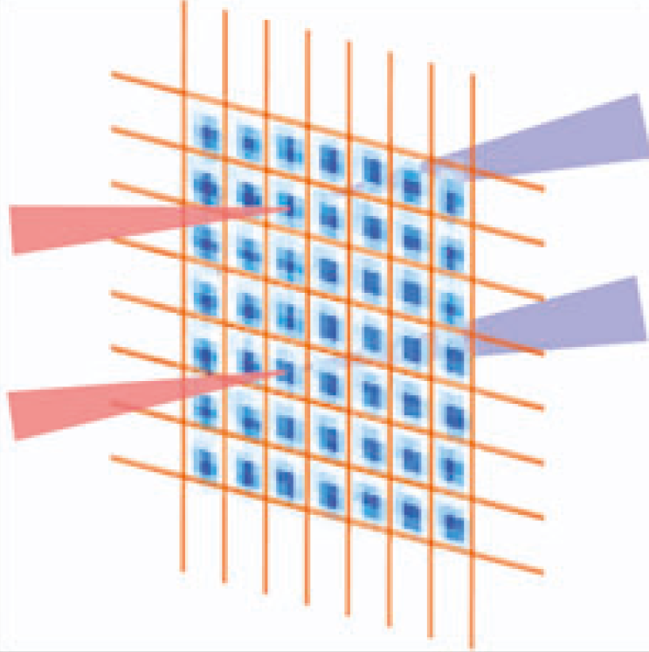
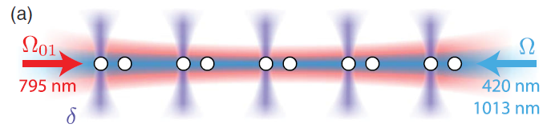
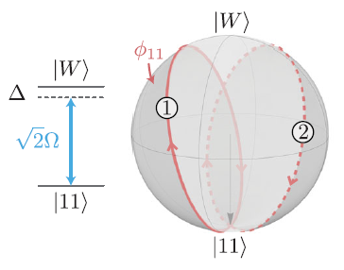
Improved two-qubit gate – Joint Illumination
Dual-addressed simultaneous CZ gate
Global-addressed simultaneous CZ gate
459 nm
1040 nm
0.76 GHz
AOD -1 order
H. Levine et al., PRL (2019)
AOD +1 order
Simultaneous CZ gate for shorter time and better coherence
Arbitrary waveform generator drives acousto-optic deflector with two tones to target two atoms.
Deflector frequency shifts are opposite for the two photons of the transition
→ site-independent Rydberg resonance

Slide 12
Improved 2Q gate fidelity – Joint Illumination
Arbitrary waveform generator drives acousto-optic deflector with two tones to target two atoms.
Deflector frequency shifts are opposite for the two photons of the transition
Individual addressing of sites 9 um apart.
Used Harvard protocol with parameters modified for weak blockade.
9 μm
H. Levine, et al. PRL 123.17 (2019)
Bell Fidelity =0.93 +/- .01 (raw)
=0.96 +/- .01 (SPAM corrected)
0
π
2π
Beam waist w=3.3 μm
d=9 μm
75s state
B_{field}=16 G
B/2π=3.0 MHz
Ω/2π=1.7 MHz
Bell Fidelity Average over 6 gates =0.90 (raw)
~0.92 (corrected)

Slide 13
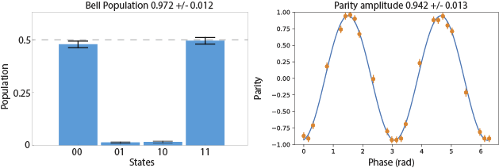
Improved 2Q gate fidelity – Joint Illumination
Arbitrary waveform generator drives acousto-optic deflector with two tones to target two atoms.
Deflector frequency shifts are opposite for the two photons of the transition
Individual addressing of sites 9 um apart.
Used Harvard protocol with parameters modified for weak blockade.
Bell Fidelity = 0.957 (raw)
= 0.982 (SPAM corrected)
H. Levine, et al. PRL 123.17 (2019)

Slide 14
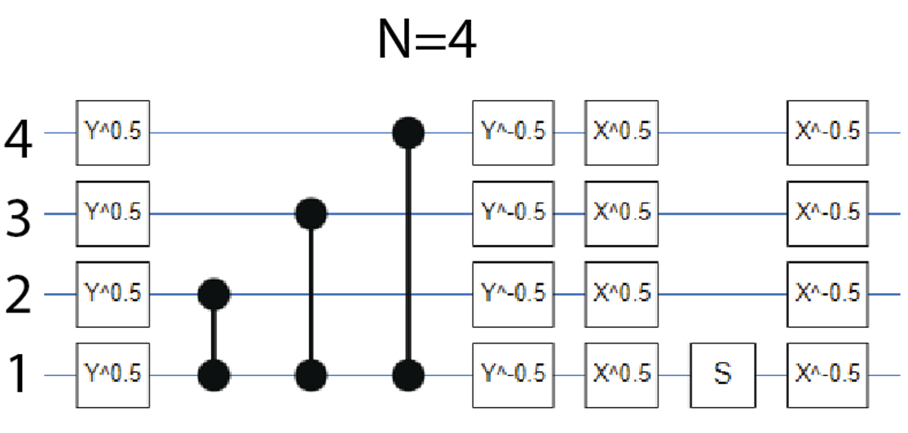
GHZ states
A good test of the computer is preparation of entangled GHZ states

Slide 15
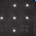
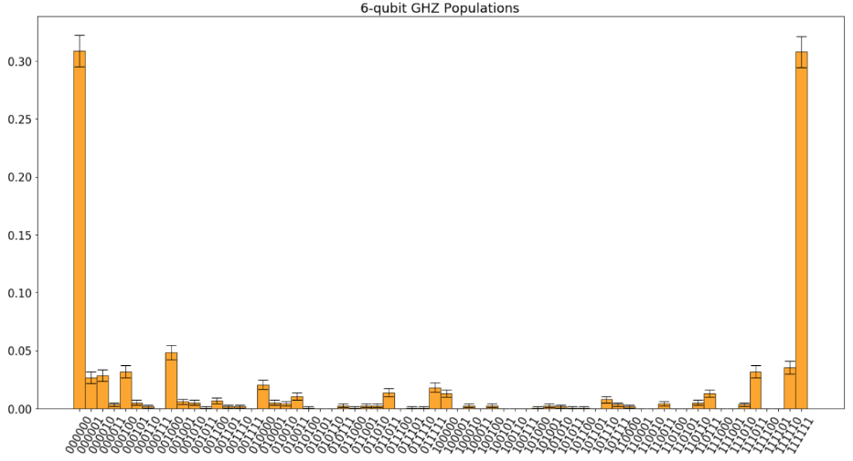
GHZ states
0.3
N=6
0

Slide 16
Phase estimation
Quantum phase estimation is one of the most important quantum algorithms. Useful for quantum chemistry and factoring.

Slide 17
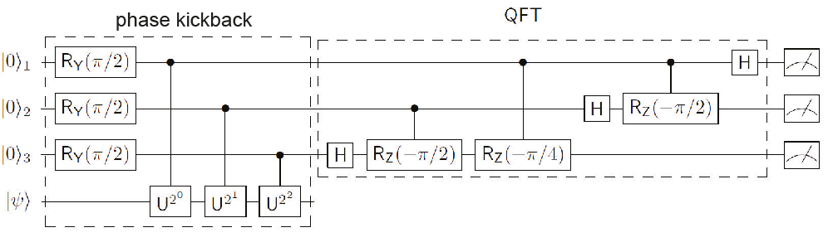
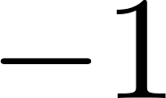
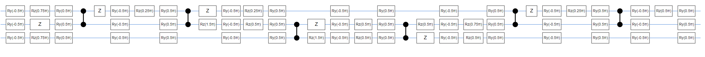
Quantum phase estimation
Quantum phase estimation is one of the most important quantum algorithms. Useful for quantum chemistry and factoring.
Test for measuring phases of 0, π/2, π, 3π/2

Slide 18
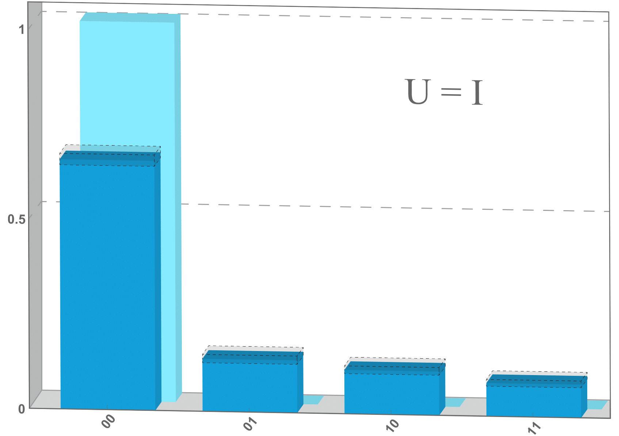
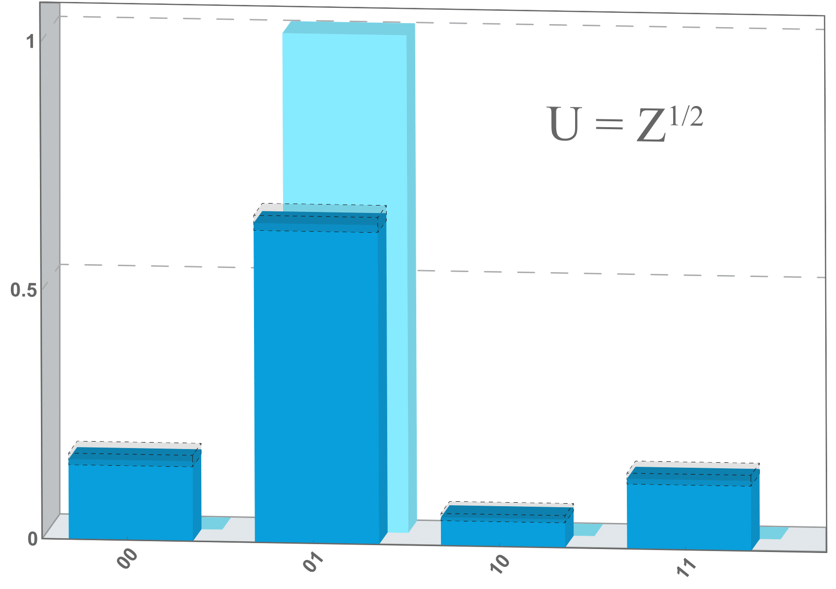
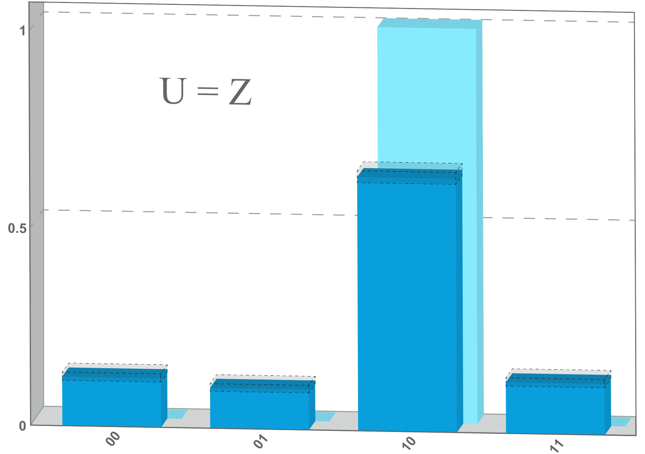
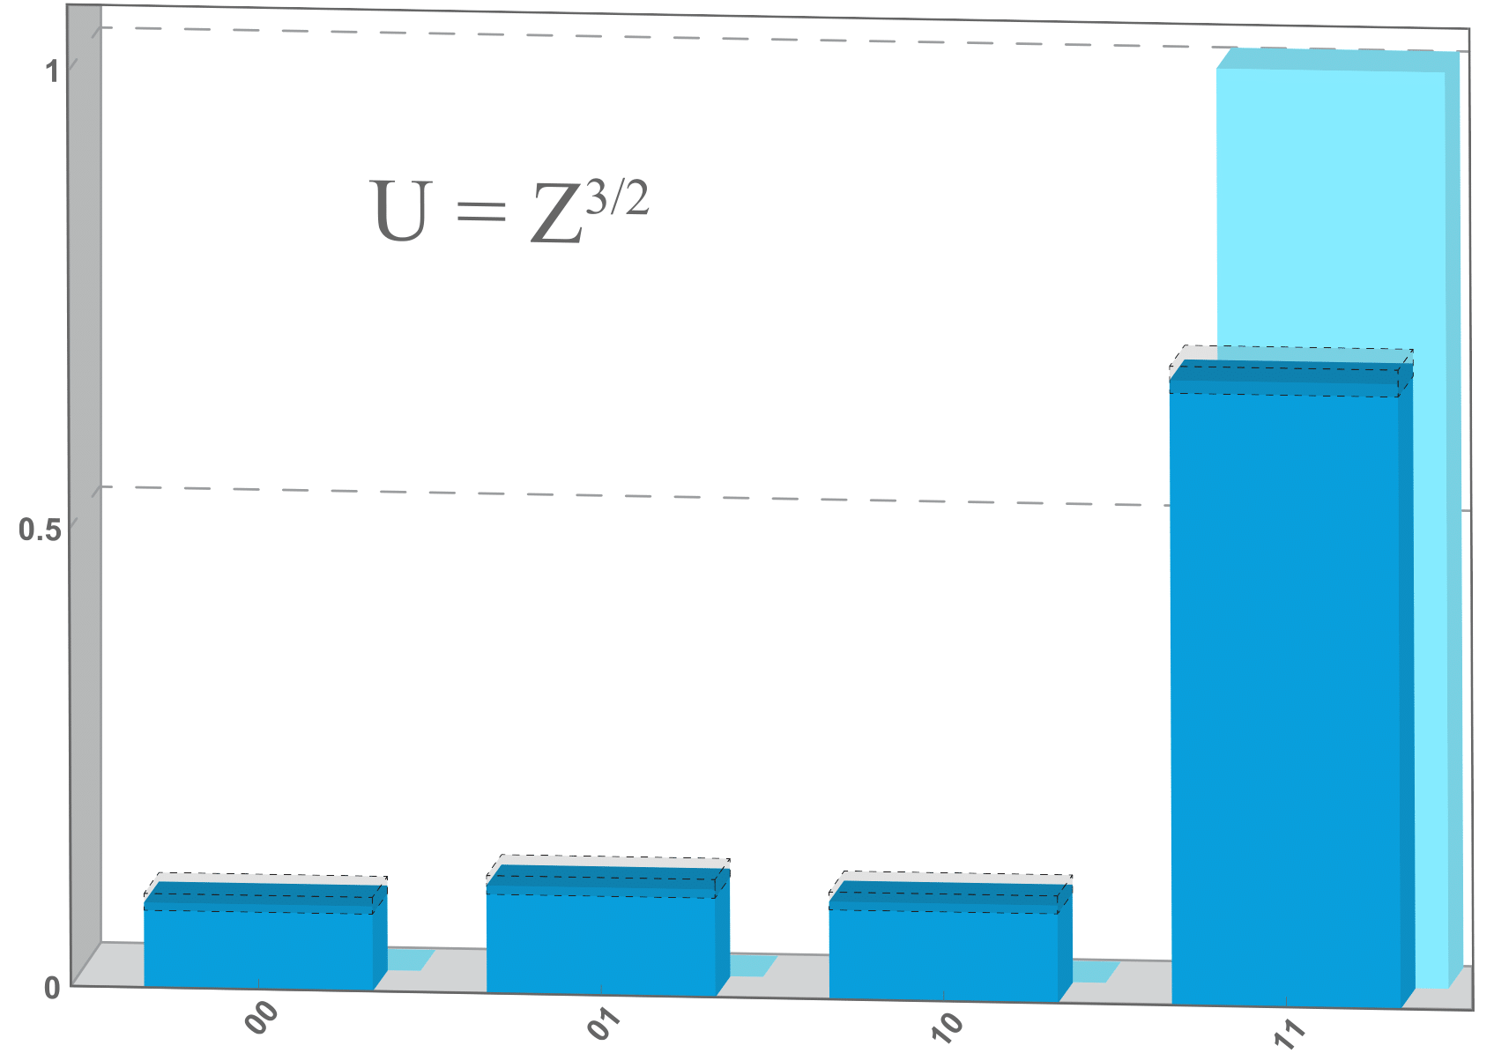
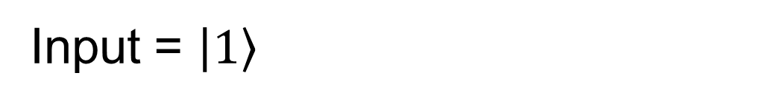
Phase estimation
Test for measuring phases of 0, π/2, π, 3π/2
Input = $\left.\left|1\right.\right\rangle$
Output register
1
U = I
U = Z^{1/2}
U = Z
U = Z^{3/2}
0.5
0
00
01
10
11
00
01
10
11
00
01
10
11
00
01
10
11

Slide 19
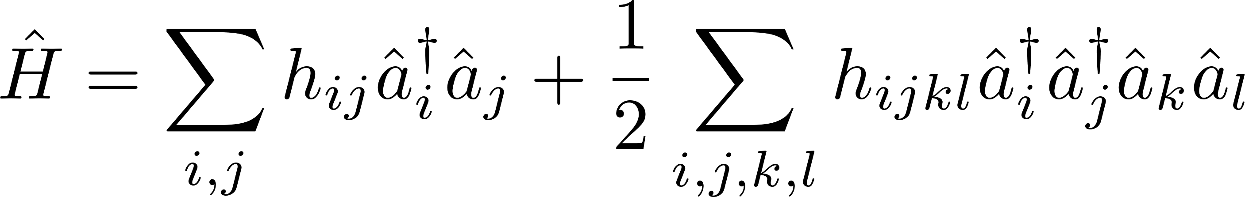
Quantum phase estimation – Hydrogen molecular energy
Hydrogen molecular Hamiltonian
qubit encoding
2-qubit Hamiltonian
P. J. J. O'Malley et al., Phys. Rev. X 6, 031007 (2016)
symmetry
1-qubit Hamiltonian
4 electronic orbitals
S. Bravyi et al., arXiv:1701.08213
Experiment
1st order Trotterization

Slide 20
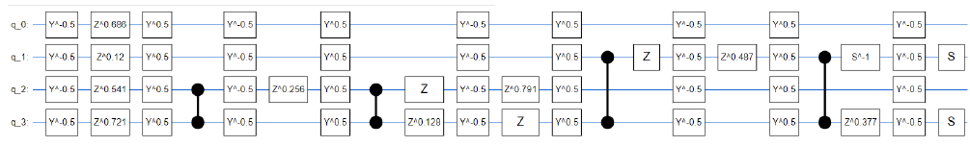
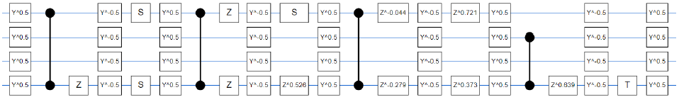
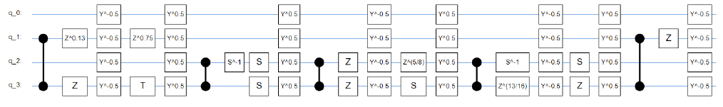
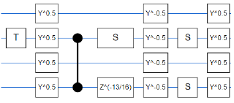
Quantum phase estimation – Hydrogen molecular energy
Hydrogen molecular Hamiltonian
qubit encoding
2-qubit Hamiltonian
P. J. J. O'Malley et al., Phys. Rev. X 6, 031007 (2016)
symmetry
1-qubit Hamiltonian
4 electronic orbitals
S. Bravyi et al., arXiv:1701.08213
Experiment
1.1 ms execution time, circuit depth of 57 1Q gates and 14 2Q gates

Slide 21
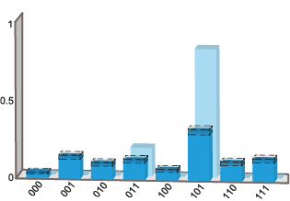


Quantum phase estimation – Hydrogen molecular energy
Hydrogen molecular Hamiltonian
qubit encoding
2-qubit Hamiltonian
P. J. J. O'Malley et al., Phys. Rev. X 6, 031007 (2016)
symmetry
1-qubit Hamiltonian
4 electronic orbitals
S. Bravyi et al., arXiv:1701.08213
Experiment
measurement qubits
well-resolved
ground energy
E_{g} = -1.06 Ha
state qubit

Slide 22

Quantum Approximate Optimization Algorithm (QAOA)
QAOA can be thought of as a discretized (Trotterized) version of adiabatic evolution.
Start the system in the ground state of a mixer Hamiltonian.
Alternate application of mixer and problem Hamiltonian.
Update weights (classical optimizer) of mixer and problem steps to arrive at ground state of problem Hamiltonian.
Example: MaxCut graph problem. Divide the vertices of a graph into two sets to maximize the number of cuts across the set boundary.
Classically hard – no polynomial time classical algorithm that can find the optimal solution for arbitrary graphs.
Farhi & Goldstone (2014)
classical weights
H_{mixer}
H_{problem}

Slide 23





QAOA MaxCut – 4 qubits
QAOA for 4 node MaxCut
q0
q3
q2
MaxCut solutions are 0001 and 1110
Noise free prediction for p=1,2,3 is AR=0.77,0.95, ~1.0
q1
6 CZ
12 CZ
18 CZ
p=1
AR=0.67
p=2
AR=0.69
p=3
AR=0.63

